Slide 1
CSE 4101 Lecture 14 Artificial Neural Network

Slide 2
Introduction to Artificial Neural Network
The term "Artificial neural network" refers to a biologically inspired sub-field of artificial intelligence modeled after the brain. An Artificial neural network is usually a computational network based on biological neural networks that construct the structure of the human brain. Similar to a human brain has neurons interconnected to each other, artificial neural networks also have neurons that are linked to each other in various layers of the networks. These neurons are known as nodes.

Slide 3
Introduction to Artificial Neural Network
The term "Artificial Neural Network" is derived from Biological neural networks that develop the structure of a human brain. Similar to the human brain that has neurons interconnected to one another, artificial neural networks also have neurons that are interconnected to one another in various layers of the networks. These neurons are known as nodes.

Slide 4
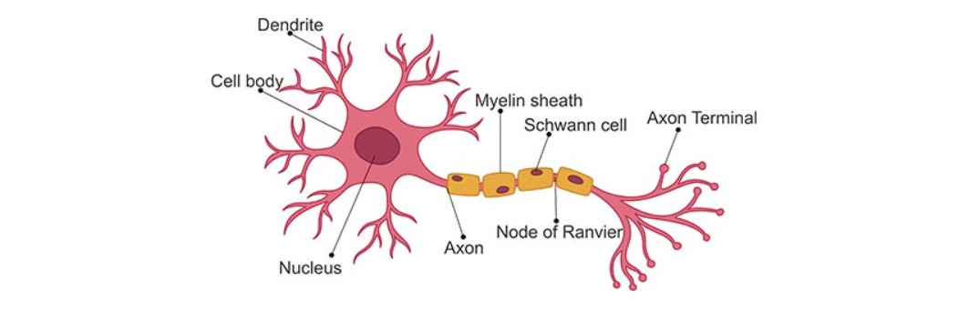
What is Biological Neuron
Specialized cell that is fundamental to the functioning of the nervous system.
Neurons are information messengers.
They use electrical and chemical signals to send information between diﬀerent areas of the brain, as well as between the brain, the spinal cord, and the entire body

Slide 5
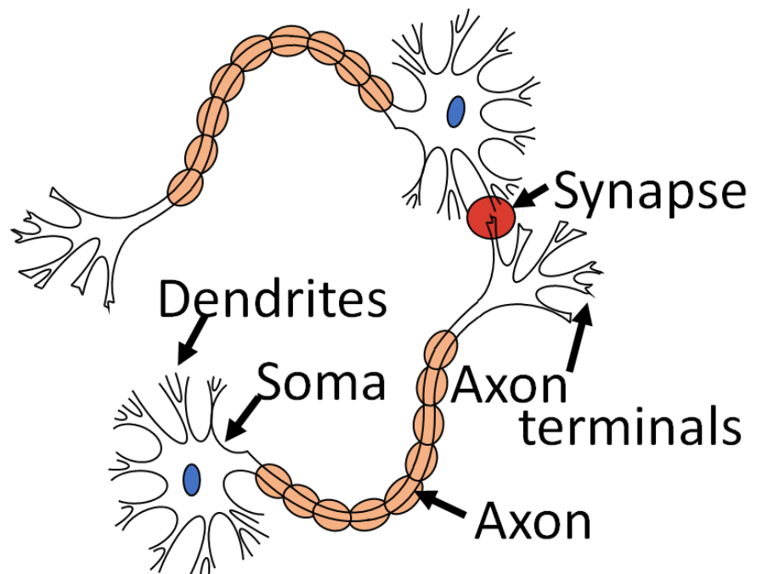
How Biological Neuron Are Connected
By the help of the synapse two
neuron are connected.

Slide 6
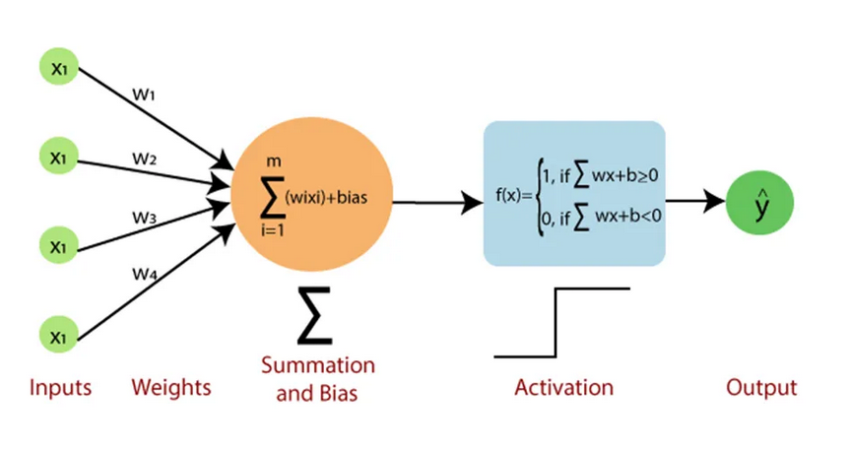
Perceptron Model: The Foundation of Neural Networks
It serves as one of the simplest forms of a neural network, making decisions based on a linear combination of its inputs. The key components of a perceptron are as follows:
Inputs: Each input is assigned a weight, signifying its importance. These weighted inputs are then summed.
Weights: These parameters are crucial in determining the influence of each input. They are adjusted during the learning process.

Slide 7
What is Perception
Summation Function: The weighted inputs are summed together, forming a linear combination.
Activation Function: The result of the summation is then passed through an activation function, often a step function, to yield the final output.

Slide 8
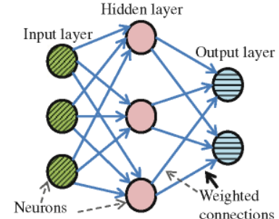
What is Neuron
Neuron is a sophisticated perception.
Multiple neuron come together to do particular task and the structure are known as neural network.

Slide 9
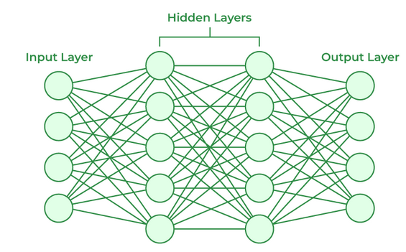
What is Artificial Neural Network
An Artificial Neural Network (ANN) is a computational model inspired by the human brain’s neural structure. It consists of interconnected nodes (artificial neurons) organized into layers. Information flows through these nodes, and the network adjusts the connection strengths (weights) during training to learn from data, enabling it to recognize patterns, make predictions, and solve various tasks in machine learning and artificial intelligence. It can range from a single layer to multiple layers of interconnected nodes (neurons) organized into layers.

Slide 10
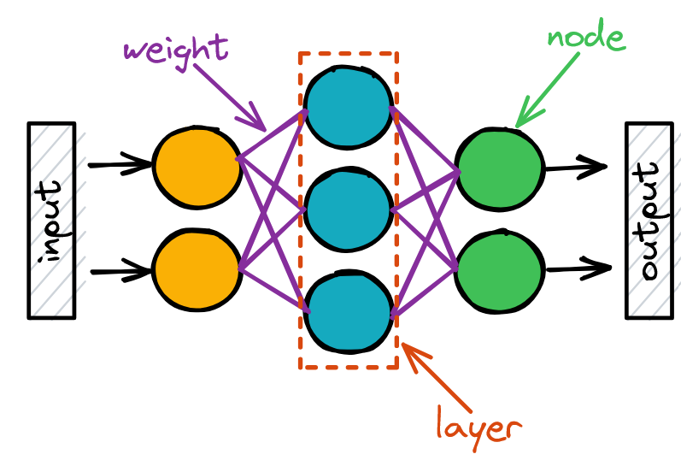
Weights
Weights are numerical values associated with the connections between neurons. They determine the strength of these connections. Weights are the coefficients that adjust the impact of incoming data. They can increase or decrease the importance of specific information.
During the training phase of a neural network, these weights are adjusted iteratively to minimize the difference between the network’s predictions and the actual outcomes. This process is related to fine-tuning the network’s ability to make accurate predictions.
Notes:
Suppose we want to build a neural network to predict a student's CGPA based on their previous semester's grades.
Each input neuron represents a different course grade from the previous semester (e.g., Math, English, Science).
The values fed into the network will be the corresponding grades.
We have one or more hidden layers that contain neurons responsible for processing the input data.
Each neuron in the hidden layer has its own set of weights.
Let's consider a single neuron in the first hidden layer.
It receives inputs from the input layer (grades of Math, English, and Science).
The weights connecting the inputs to this neuron might be:
Math Grade Weight = 0.4
English Grade Weight = 0.6
Science Grade Weight = 0.2
The weighted sum is calculated as follows :Weighted Sum = (Math Grade * 0.4) + (English Grade * 0.6) + (Science Grade * 0.2)
The final output layer consists of a single neuron representing the predicted CGPA.
The outputs from the previous layer are used as inputs, and their weights are determined accordingly.
Conclusion:
Weights in the neural network determine the importance or contribution of each input feature to the final CGPA prediction.
Adjusting the weights optimizes the network's ability to make accurate CGPA predictions.

Slide 11
Weights
The weight values are first randomly initialized and then learned, updated, and optimized by the network during the training process.
Let’s consider a practical example to illustrate the role of weights. Suppose you’re building a neural network to recognize handwritten digits. Each pixel in an image of a digit can be considered an input to the network. The weights associated with each pixel determine how much importance the network places on that pixel when making a decision about which digit is represented in the image.
As the network learns from a dataset of labeled digits, it adjusts these weights to give more significance to pixels that are highly correlated with the correct digit and less significance to pixels that are less relevant. Over time, the network learns to recognize patterns in the data and make accurate predictions.
Notes:
Suppose we want to build a neural network to predict a student's CGPA based on their previous semester's grades.
Each input neuron represents a different course grade from the previous semester (e.g., Math, English, Science).
The values fed into the network will be the corresponding grades.
We have one or more hidden layers that contain neurons responsible for processing the input data.
Each neuron in the hidden layer has its own set of weights.
Let's consider a single neuron in the first hidden layer.
It receives inputs from the input layer (grades of Math, English, and Science).
The weights connecting the inputs to this neuron might be:
Math Grade Weight = 0.4
English Grade Weight = 0.6
Science Grade Weight = 0.2
The weighted sum is calculated as follows :Weighted Sum = (Math Grade * 0.4) + (English Grade * 0.6) + (Science Grade * 0.2)
The final output layer consists of a single neuron representing the predicted CGPA.
The outputs from the previous layer are used as inputs, and their weights are determined accordingly.
Conclusion:
Weights in the neural network determine the importance or contribution of each input feature to the final CGPA prediction.
Adjusting the weights optimizes the network's ability to make accurate CGPA predictions.

Slide 12
Bias
While weights determine the strength of connections between neurons, biases provide a critical additional layer of flexibility to neural networks. Biases are essentially constants associated with each neuron. Unlike weights, biases are not connected to specific inputs but are added to the neuron’s output.
Biases serve as a form of offset or threshold, allowing neurons to activate even when the weighted sum of their inputs is not sufficient on its own. They introduce a level of adaptability that ensures the network can learn and make predictions effectively.
To understand the role of biases, consider a simple example. Imagine a neuron that processes the brightness of an image pixel. Without a bias, this neuron might only activate when the pixel’s brightness is exactly at a certain threshold. However, by introducing a bias, you allow the neuron to activate even when the brightness is slightly below or above the threshold.
Notes:
In this scenario, we have a neural network with a single input feature: the number of hours a student studied for the exam. The output of the network will be either a 1 (pass) or 0 (fail).
Without biases: Suppose the weight assigned to the study hours feature is 0.2. If a student didn't study at all (study hours = 0), the weighted sum of the input would also be zero (0 * 0.2 = 0). Without biases, the output of the network would be zero as well, indicating a predicted failure. In this case, the network would always predict failure when the study hours are zero.
With biases: Now, let's introduce a bias term of -1. This bias term is added to the weighted sum of the input before passing through the activation function.
Considering the same scenario where study hours = 0, the weighted sum of the input would still be zero. However, with the bias term, the network's output would be 0 - 1 = -1 instead of zero. This means that even with zero study hours, the network can still predict a non-zero value (-1 in this case), indicating a predicted failure. The bias term allows the network to make non-zero predictions even when the input value is zero.
In this example, the bias term represents a baseline assumption that even if a student didn't study, there is still a tendency to predict failure. It captures the idea that factors other than study hours, such as prior knowledge or external circumstances, can influence the outcome of the exam.
The bias term provides flexibility to the neural network, allowing it to make predictions that are not solely determined by the input value and incorporating additional information or tendencies that affect the output.

Slide 13
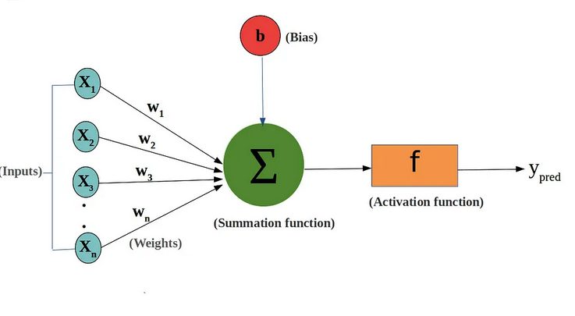
Bias
This flexibility is crucial because real-world data is rarely perfectly aligned with specific thresholds. Biases enable neurons to activate in response to various input conditions, making neural networks more robust and capable of handling complex patterns.
Notes:
In this scenario, we have a neural network with a single input feature: the number of hours a student studied for the exam. The output of the network will be either a 1 (pass) or 0 (fail).
Without biases: Suppose the weight assigned to the study hours feature is 0.2. If a student didn't study at all (study hours = 0), the weighted sum of the input would also be zero (0 * 0.2 = 0). Without biases, the output of the network would be zero as well, indicating a predicted failure. In this case, the network would always predict failure when the study hours are zero.
With biases: Now, let's introduce a bias term of -1. This bias term is added to the weighted sum of the input before passing through the activation function.
Considering the same scenario where study hours = 0, the weighted sum of the input would still be zero. However, with the bias term, the network's output would be 0 - 1 = -1 instead of zero. This means that even with zero study hours, the network can still predict a non-zero value (-1 in this case), indicating a predicted failure. The bias term allows the network to make non-zero predictions even when the input value is zero.
In this example, the bias term represents a baseline assumption that even if a student didn't study, there is still a tendency to predict failure. It captures the idea that factors other than study hours, such as prior knowledge or external circumstances, can influence the outcome of the exam.
The bias term provides flexibility to the neural network, allowing it to make predictions that are not solely determined by the input value and incorporating additional information or tendencies that affect the output.

Slide 14
The Learning Process: Forward and Backward Propagation
Forward propagation is the initial phase of processing input data through the neural network to produce an output or prediction. Here’s how it works:
Input Layer: The input data is fed into the neural network’s input layer.
Weighted Sum: Each neuron in the subsequent layers calculates a weighted sum of the inputs it receives, where the weights are the adjustable parameters.
Adding Biases: To this weighted sum, the bias associated with each neuron is added. This introduces an offset or threshold for activation.

Slide 15
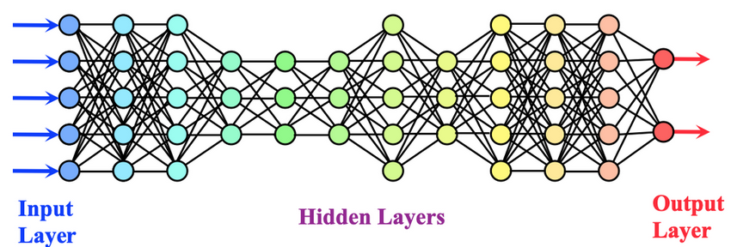
Forward Propagation
Activation Function: The result of the weighted sum plus bias is passed through an activation function. This function determines whether the neuron should activate or remain dormant based on the calculated value.
Propagation: The output of one layer becomes the input for the next layer, and the process repeats until the final layer produces the network’s prediction.

Slide 16
Backward Propagation
Once the network has made a prediction, it’s essential to evaluate how accurate that prediction is and make adjustments to improve future predictions. This is where backward propagation comes into play.
Error Calculation: The prediction made by the network is compared to the actual target or ground truth. The resulting error, often quantified as a loss or cost, measures the disparity between prediction and reality.
Gradient Descent: Backward propagation involves minimizing this error. To do so, the network calculates the gradient of the error with respect to the weights and biases.
Notes:
Imagine training a neural network is like teaching a student. Backpropagation is
like correcting the student's mistakes after a practice session. The student (neural network)
attempts to solve a problem and gets an answer. Then, the teacher (backpropagation) checks
the answer against the correct one and points out the mistakes made.
Using the feedback from the teacher, the student adjusts their understanding and learns from the errors.

Slide 17
Backward Propagation
Weight and Bias Updates: The network uses this gradient information to update the weights and biases throughout the network. The goal is to find the values that minimize the error.
Iterative Process: This process of forward and backward propagation is repeated iteratively on batches of training data. With each iteration, the network’s weights and biases get closer to values that minimize the error.
In essence, backward propagation fine-tunes the network’s parameters, adjusting weights and biases to make the network’s predictions more accurate. This iterative learning process continues until the network achieves a satisfactory level of performance on the training data.
Notes:
Imagine training a neural network is like teaching a student. Backpropagation is
like correcting the student's mistakes after a practice session. The student (neural network)
attempts to solve a problem and gets an answer. Then, the teacher (backpropagation) checks
the answer against the correct one and points out the mistakes made.
Using the feedback from the teacher, the student adjusts their understanding and learns from the errors.

Slide 18
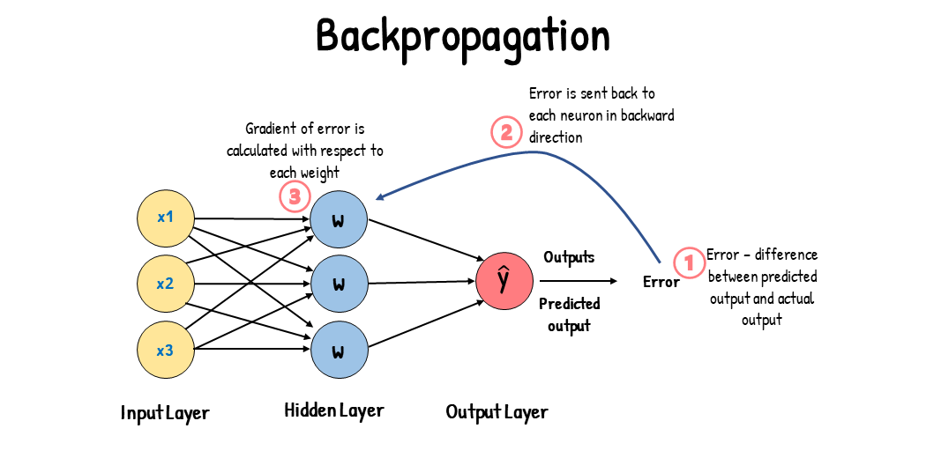
Backward Propagation
Notes:
Imagine training a neural network is like teaching a student. Backpropagation is
like correcting the student's mistakes after a practice session. The student (neural network)
attempts to solve a problem and gets an answer. Then, the teacher (backpropagation) checks
the answer against the correct one and points out the mistakes made.
Using the feedback from the teacher, the student adjusts their understanding and learns from the errors.

Slide 19
Importance of Activation Function
Without activation functions, neural networks would just consist of linear operations like matrix multiplication. All layers would perform linear transformations of the input, and no non-linearities would be introduced.
Most real-world data is non-linear. For example, relationships between house prices and size, income, and purchases, etc., are non-linear. If neural networks had no activation functions, they would fail to learn the complex non-linear patterns that exist in real-world data.
Activation functions enable neural networks to learn these non-linear relationships by introducing non-linear behaviors through activation functions. This greatly increases the flexibility and power of neural networks to model complex data.
Notes:
If we can not apply the activation function to the neural network
then it can not capture the non linear data only capture the linear data.

Slide 20
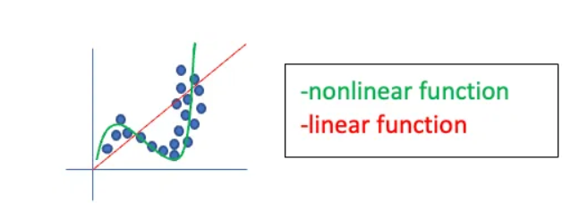
Importance of Activation Function
Type of activation function:
Sigmoid Function
Tanh(Hyperbolic-Tangent)
Rectified Linear Unit(ReLU)
SoftMax Function…etc.
Notes:
If we can not apply the activation function to the neural network
then it can not capture the non linear data only capture the linear data.

Slide 21
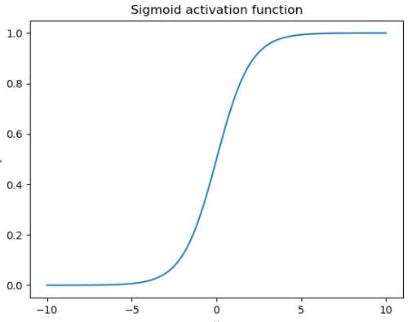

Sigmoid Function
The sigmoid function is a mathematical function that has a characteristic that can take any real value and map it to between 0 to 1 shaped like the letter “S”.
The sigmoid function is also known as a logistic function.
Mathematical definition of sigmoid,

Slide 22
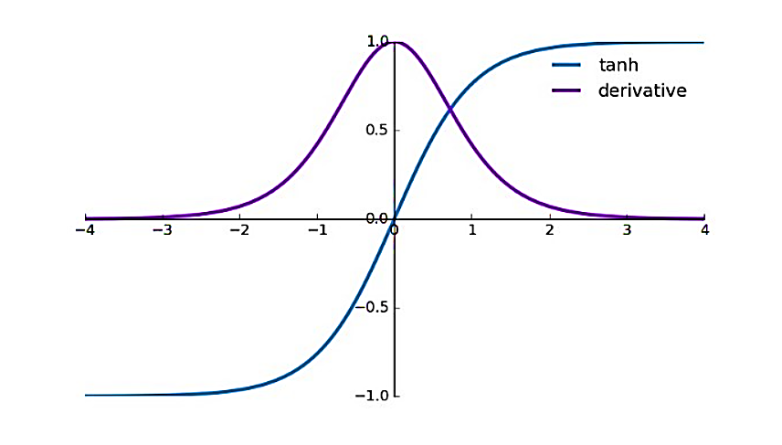
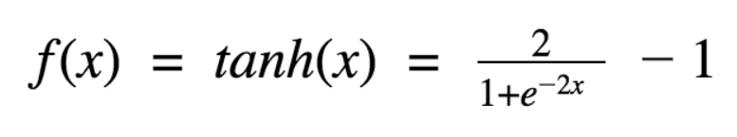
Tanh Function
The tanh(hyperbolic tangent) function became preferred over the sigmoid function as it gives better performance for multi-layer neural networks. It is zero centered activation function.
Mathematical definition of tanh,
Notes:
Advantages:
Non-linear
Differentiable.
Zero Centered.

Slide 23
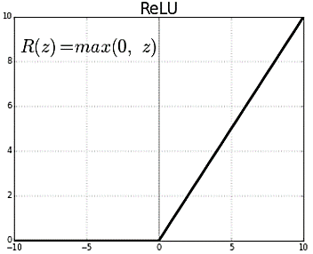

ReLU Function
ReLu(Rectified Linear Unit) is a non-linear activation function that is used in multi-layer neural network or deep neural networks. This function can be represented as:
f(x)=max(0,x) where, x an input value.
According to equation 1, the output of ReLu is the maximum value between zero and the input value. An output is equal to zero when the input value is negative and the input value when the input is positive. Thus, we can rewrite equation 1 as follows:

Slide 24
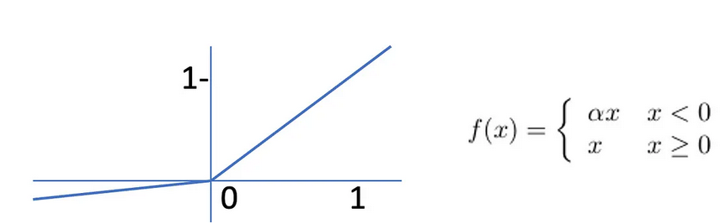
Leaky ReLU Function
A shallow slope is added for negative x by using alpha (normally small e.g. 0.01). This keeps nodes with negative values of x active. Again, this is easy to compute, and runs from -infinity to infinity, meaning it is almost zero-centred. This makes future layer calculations easier to process. Leaky ReLU is also a very popular choice as the activation function for hidden layers.

Slide 25
Thank You

